Slide 1
Nondeterministic Finite Automata
Nondeterminism
Subset Construction

Slide 2
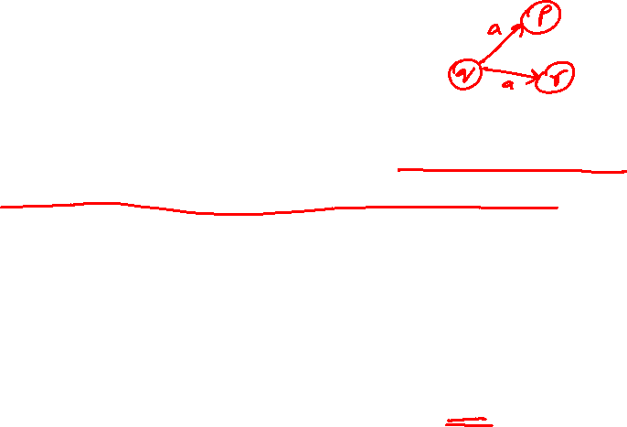
Nondeterministic Finite Automata (NFA)
Same as a DFA, except:
  On input a, state q may have more than one transition out, implying the possibility of multiple choices when processing an input symbol
  On input a, state q may have no transition out, implying the possibility of “being stuck”
A string is w acceptable if any sequence of choices of states leads to a final state.
An NFA must be drawn using RE

Slide 3
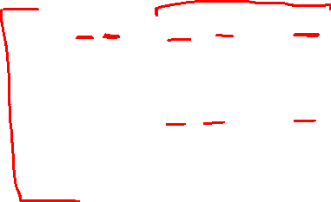
Formal Definition of NFA
A NFA consists of:
  A finite set of states (Q).
  An input alphabet (Σ).
  A start state (q₀ is in Q)
  A set of final/accepting states (F ⊆ Q)
  A transition function (δ: Q x Σ → 2^{Q})
    δ(q_{i}, a) = {q_{i1}, q_{i2} … , q_{ik}} indicates that if the current state is q_{i} and it just read the symbol a then the NFA can go from state q_{i} to any of the states in {q_{i1}, q_{i2} … , q_{ik}} ⊆ Q
    An NFA, M = (Q, Σ, q₀, F, δ)

Slide 4
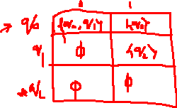
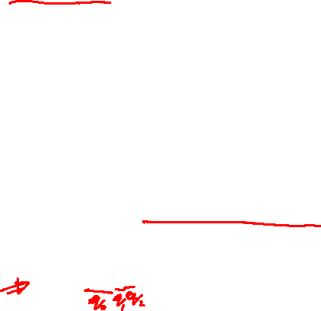
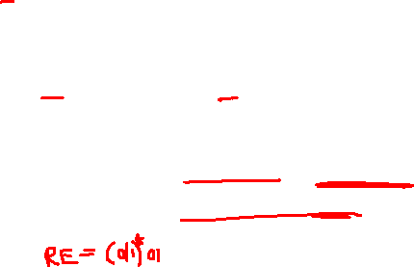
Example NFA
NFA that recognizes the language of binary strings that end in 01
0,1
Exercise:
write the complete transition table for this NFA
0
q₁
1
q₂
q₀
note: δ(q₀,0) = {q₀,q₁}
δ(q₁,0) = Ф

Slide 5
How does this NFA know where to go from q₀ upon 0?
0,1
It doesn’t; it tries all possible paths, if any path leads to a final state then the string is accepted
E.g., for input string 00101, possible transitions are:
q₀
0
q₁
1
q₂
q₀
0
q₀
0
q₀
1
q₀
0
q₀
1
q₀
0
q₁
0
q₁
0
q₁
0
1
1
q₂
q₂
*
Ф
0
Ф

Slide 6
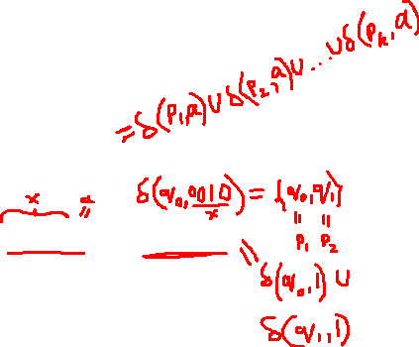
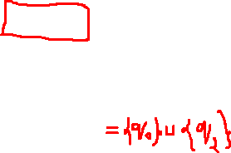
Transition Function of an NFA
δ(q, a) is a set of states.
It can be extended to strings as follows:
Basis: δ(q, ε) = {q}
Induction: δ(q, xa) = U^{k}_{i=1} δ(p_{i}, a) where δ(q, x) = {p₁,p₂, …, p_{k}}
E.g., in the last NFA δ(q₀, 00101) = {q₀,q₂}
q₀
0
q₀
0
q₀
1
q₀
0
q₀
1
q₀
0
q₁
0
q₁
0
q₁
0
1
1
q₂
q₂
*
Ф
0
Ф

Slide 7
Language of an NFA
A string w is accepted by an NFA if δ(q₀, w) contains at least one final state.
The language of the NFA is the set of strings it accepts, i.e.,
  L(M) = {w| there is a state q ε δ(q₀, w) such that q ε F}

Slide 8
DFA to NFA conversion
Any DFA can be turned into an NFA that accepts the same language.
If δ_{D}(q, a) = p, let the NFA have δ_{N}(q, a) = {p}.
Then the NFA is always in a set containing exactly one state – the state the DFA is in after reading the same input.

Slide 9
E.g. DFA to NFA conversion
Design a DFA that accepts all strings that ends with a 01, convert this DFA to an NFA, and write the transition table of that NFA
Required states:
  q0: last symbol read was not 0
  q1: last symbol read was 0
  q2: last two symbols read were 0, and then 1
1
0
A
0
B
1
C
0
1

Slide 10
E.g. DFA to NFA conversion
Transition table of this DFA:
Transition table of equivalent NFA:
State | 0 | 1
→A | B | A
B | B | C
*C | B | A
1
0
A
0
B
1
C
0
1
State | 0 | 1
→A | {B} | {A}
B | {B} | {C}
*C | {B} | {A}

Slide 11
NFA to DFA Conversion
Surprisingly, for any NFA there is a DFA that accepts the same language.
An NFA can be converted to an equivalent DFA via subset construction

Slide 12
Subset Construction
Given a NFA, M = (Q, Σ, δ, q₀, F), build a DFA, M’ = (Q’, Σ, δ’, q₀’, F’) as follows:
  Q’ is a subset of 2^{Q} (the powerset of Q)
  q₀’ = {q₀}
  F’ = all subsets of Q that contain one or more element(s) of F
  How to obtain δ’?

Slide 13
Subset Construction (2)
  δ’(S, a) is the union of all states that are reachable via a transition from each state in S upon reading the symbol a: δ’(S, a) = U_{q∈S} δ(q, a)
  Finally, remove those states in Q’ that are not reachable from q₀’ = {q₀}
    Faster/Lazy way of subset construction: starting from q₀’, compute δ’ for only those states that are reachable from q₀’; thus you may be able to skip many elements of 2^{Q}

Slide 14

Subset Construction Example
NFA: accepts all strings that end with 01
Transition table of this NFA
0,1
q₀
0
q₁
1
q₂
State | 0 | 1
→q₀ | {q₀, q₁} | {q₀}
q₁ | Ф | {q₂}
*q₂ | Ф | Ф

Slide 15
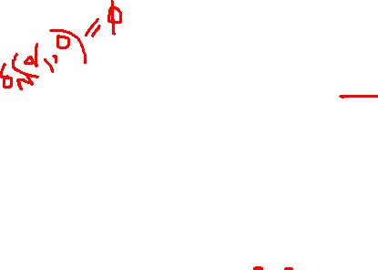
Subset Construction Example
Transition table of NFA
Forming transition table of Equivalent DFA
State | 0 | 1
→q₀ | {q₀, q₁} | {q₀}
q₁ | Ф | {q₂}
*q₂ | Ф | Ф
State | 0 | 1
→{q₀} | {q₀, q₁} | {q₀}

Slide 16
Subset Construction Example
Transition table of NFA
Forming transition table of Equivalent DFA
State | 0 | 1
→q₀ | {q₀, q₁} | {q₀}
q₁ | Ф | {q₂}
*q₂ | Ф | Ф
State | 0 | 1
→{q₀} | {q₀, q₁} | {q₀}
{q₀, q₁} | ?
δ’({q₀, q₁}, 0) = δ(q₀,0) U δ(q₁,0) = {q₀, q₁} U Ф = {q₀,q₁}

Slide 17
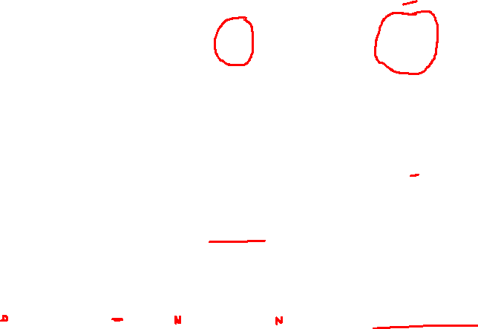
Subset Construction Example
Transition table of NFA
Forming transition table of Equivalent DFA
State | 0 | 1
→q₀ | {q₀, q₁} | {q₀}
q₁ | Ф | {q₂}
*q₂ | Ф | Ф
State | 0 | 1
→{q₀} | {q₀, q₁} | {q₀}
{q₀, q₁} | {q₀, q₁} | ?
δ’({q₀, q₁}, 1) = δ(q₀,1) U δ(q₁,1) = {q₀} U {q₂} = {q₀,q₂}

Slide 18
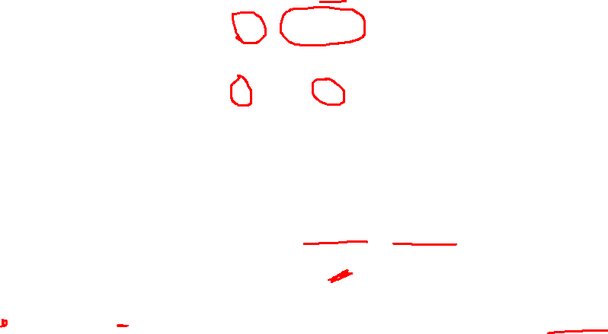
Subset Construction Example
Transition table of NFA
Forming transition table of Equivalent DFA
State | 0 | 1
→q₀ | {q₀, q₁} | {q₀}
q₁ | Ф | {q₂}
*q₂ | Ф | Ф
State | 0 | 1
→{q₀} | {q₀, q₁} | {q₀}
{q₀, q₁} | {q₀, q₁} | {q₀, q₂}
{q₀, q₂} | ?
δ’({q₀, q₂}, 0) = δ(q₀,0) U δ(q₂,0) = {q₀,q₁} U Ф = {q₀,q₁}

Slide 19
Subset Construction Example
Transition table of NFA
Forming transition table of Equivalent DFA
State | 0 | 1
→q₀ | {q₀, q₁} | {q₀}
q₁ | Ф | {q₂}
*q₂ | Ф | Ф
State | 0 | 1
→{q₀} | {q₀, q₁} | {q₀}
{q₀, q₁} | {q₀, q₁} | {q₀, q₂}
{q₀, q₂} | {q₀, q₁} | ?
δ’({q₀, q₂}, 1) = δ(q₀,1) U δ(q₂,1) = {q₀} U Ф = {q₀}

Slide 20
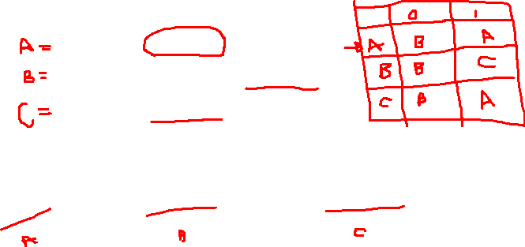
Subset Construction Example
Transition table+diagram of Equivalent DFA
State | 0 | 1
→{q₀} | {q₀, q₁} | {q₀}
{q₀, q₁} | {q₀, q₁} | {q₀, q₂}
*{q₀, q₂} | {q₀, q₁} | {q₀}
1
0
0
{q₀,q₁}
1
{q₀,q₂}
{q₀ }
0
1
A state in equivalent DFA will be a final state if its corresponding set of NFA states contain one or more final states of the NFA. E.g. {q0,q2} is a final state of DFA because q2 is a final state in NFA

Slide 21
Critical Point
The DFA states have names that are sets of NFA states.
But as a DFA state, an expression like {p,q} must be read as a single state, not as a set.

Slide 22
Example: NFA to DFA
1
2
3
4
5
6
7
8
9
For our chessboard NFA we saw that rbb is accepted.
If the input consists of only b’s, the set of accessible states alternates between {5} and {1,3,7,9}, so only even-length, nonempty strings of b’s are accepted.
Can we design an NFA for this? What should the eqv. DFA look like?

Slide 23
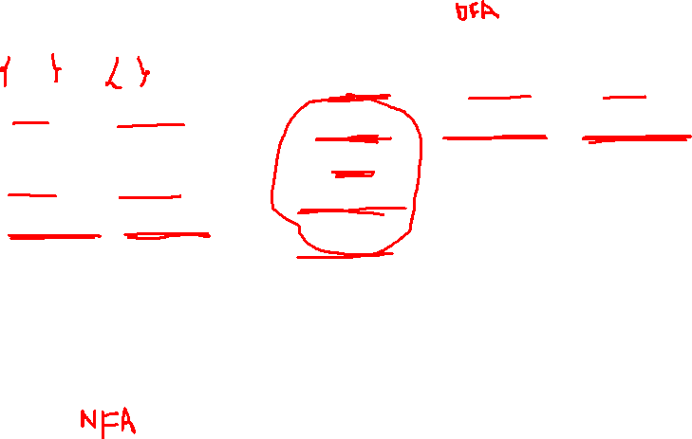
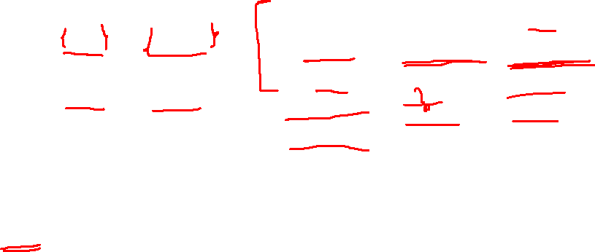
Example: Subset Construction
r b
2,4 5
4,6 1,3,5
2,6 5
2,8 1,5,7
2,4,6,8 1,3,7,9
2,8 3,5,9
4,8 5
4,6 5,7,9
6,8 5
r b
{1}
{2,4} {5}
{2,4}
{2,4,6,8} {1,3,5,7}
{5}
{2,4,6,8}
{1,3,5,7}
*

Slide 24
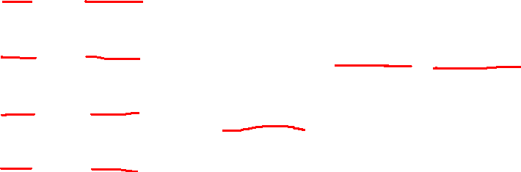

Example: Subset Construction
r b
2,4 5
4,6 1,3,5
2,6 5
2,8 1,5,7
2,4,6,8 1,3,7,9
2,8 3,5,9
4,8 5
4,6 5,7,9
6,8 5
r b
{1}
{2,4} {5}
{2,4}
{2,4,6,8} {1,3,5,7}
{5}
{2,4,6,8} {1,3,7,9}
{2,4,6,8}
{1,3,5,7}
* {1,3,7,9}
*

Slide 25
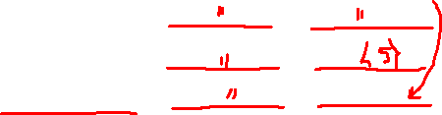
Example: Subset Construction
r b
2,4 5
4,6 1,3,5
2,6 5
2,8 1,5,7
2,4,6,8 1,3,7,9
2,8 3,5,9
4,8 5
4,6 5,7,9
6,8 5
r b
{1}
{2,4} {5}
{2,4}
{2,4,6,8} {1,3,5,7}
{5}
{2,4,6,8} {1,3,7,9}
{2,4,6,8}
{2,4,6,8} {1,3,5,7,9}
{1,3,5,7}
* {1,3,7,9}
* {1,3,5,7,9}
*

Slide 26
Example: Subset Construction
r b
2,4 5
4,6 1,3,5
2,6 5
2,8 1,5,7
2,4,6,8 1,3,7,9
2,8 3,5,9
4,8 5
4,6 5,7,9
6,8 5
r b
{1}
{2,4} {5}
{2,4}
{2,4,6,8} {1,3,5,7}
{5}
{2,4,6,8} {1,3,7,9}
{2,4,6,8}
{2,4,6,8} {1,3,5,7,9}
{1,3,5,7}
{2,4,6,8} {1,3,5,7,9}
* {1,3,7,9}
* {1,3,5,7,9}
*

Slide 27
Example: Subset Construction
r b
2,4 5
4,6 1,3,5
2,6 5
2,8 1,5,7
2,4,6,8 1,3,7,9
2,8 3,5,9
4,8 5
4,6 5,7,9
6,8 5
r b
{1}
{2,4} {5}
{2,4}
{2,4,6,8} {1,3,5,7}
{5}
{2,4,6,8} {1,3,7,9}
{2,4,6,8}
{2,4,6,8} {1,3,5,7,9}
{1,3,5,7}
{2,4,6,8} {1,3,5,7,9}
* {1,3,7,9}
{2,4,6,8} {5}
* {1,3,5,7,9}
*

Slide 28
Example: Subset Construction
r b
2,4 5
4,6 1,3,5
2,6 5
2,8 1,5,7
2,4,6,8 1,3,7,9
2,8 3,5,9
4,8 5
4,6 5,7,9
6,8 5
r b
{1}
{2,4} {5}
{2,4}
{2,4,6,8} {1,3,5,7}
{5}
{2,4,6,8} {1,3,7,9}
{2,4,6,8}
{2,4,6,8} {1,3,5,7,9}
{1,3,5,7}
{2,4,6,8} {1,3,5,7,9}
* {1,3,7,9}
{2,4,6,8} {5}
* {1,3,5,7,9}
{2,4,6,8} {1,3,5,7,9}
*

Slide 29
NFA for binary strings that contain 101
RE = (0|1)*101(0|1)*
Check if this NFA accepts the string 01010
Solution:
0 => {q}, 1=>{q,q₁}, 0=>{q, q₁₀}, 1=>{q,q₁,q₁₀₁}, 0=> {q, q₁₀, q₁₀₁} Accepted as q₁₀₁ is a final state
0,1
0,1
q
1
q₁
0
q₁₀
1
q₁₀₁
Final dead state: final state from which we can’t escape
q₁₀₁
start

Slide 30
Convert this NFA to equivalent DFA
RE = (0|1)*101(0|1)*
0,1
0,1
A
1
B
0
C
1
q₁₀₁
D
Equivalent DFA
start
state | 0 | 1
->{A} | {A} | {A,B}
{A,B} | {A,C} | {A,B}
{A,C} | {A} | {A,B,D}
*{A,B,D} | {A,C,D} | {A,B,D}
*{A,C,D} | {A,D} | {A,B,D}
*{A,D} | {A,D} | {A,B,D}
NFA
state | 0 | 1
->A | {A} | {A,B}
B | {C} | ∅
C | ∅ | {D}
*D | {D} | {D}

Slide 31
Simplification of equivalent DFA
Equivalent DFA
state | 0 | 1
->{A} | {A} | {A,B}
{A,B} | {A,C} | {A,B}
{A,C} | {A} | {A,B,D}
*{A,B,D} | {A,C,D} | {A,B,D}
*{A,C,D} | {A,D} | {A,B,D}
*{A,D} | {A,D} | {A,B,D}
Simplification of Equivalent DFA
state | 0 | 1
->{A} | {A} | {A,B}
{A,B} | {A,C} | {A,B}
{A,C} | {A} | {A,B,D}
*{A,B,D} | {A,B,D} | {A,B,D}

